Slide 1

Analysis of CO2 emissions and affecting factors
BMIS - 2542
Peng Yuan

Slide 2
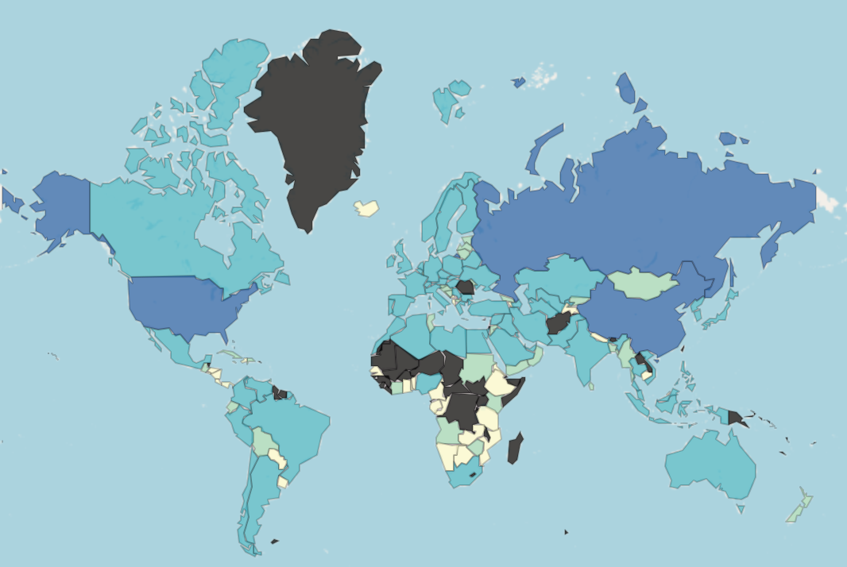
Global CO2 damage background
The blue color from light to dark represents the data from low to high. A visualization of CO2 Damage data for all countries reveals that China, Russian Federation, and the United States have particularly significant emissions

Slide 3
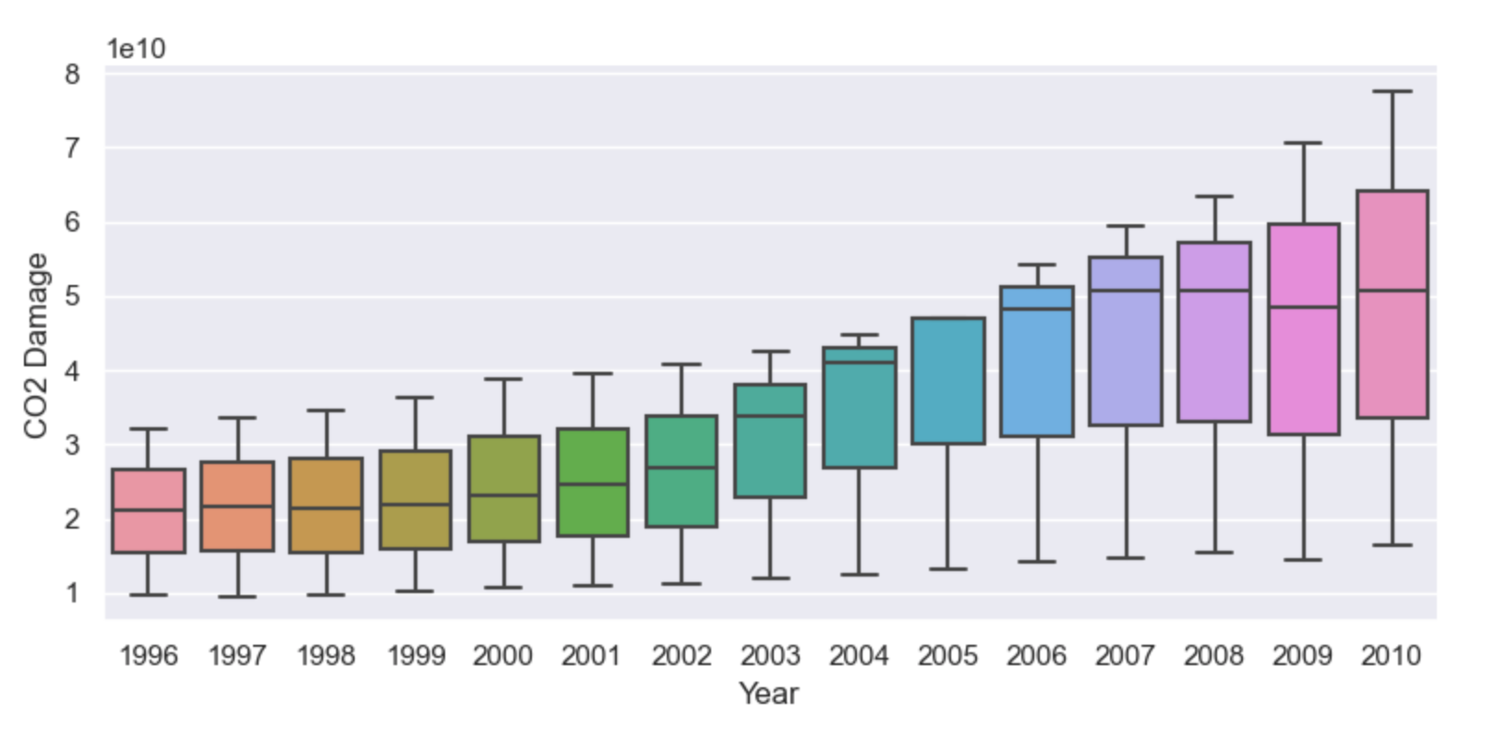
CO2 Damage Overall Trend
There is an overall upward trend in the CO2 Damage data for the three countries. The growth rate of the data has increased since 2000. A certain downward trend is found in the 2009 data.
Notes:
In order to further investigate the reasons for the change in trend, we visualize the trend of CO2 Damage data for each of the three countries.

Slide 4
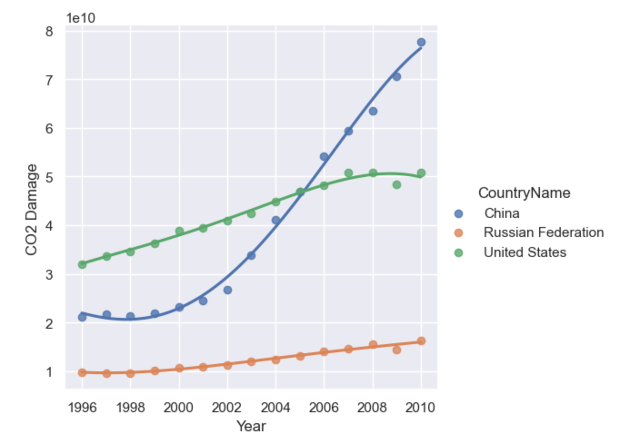
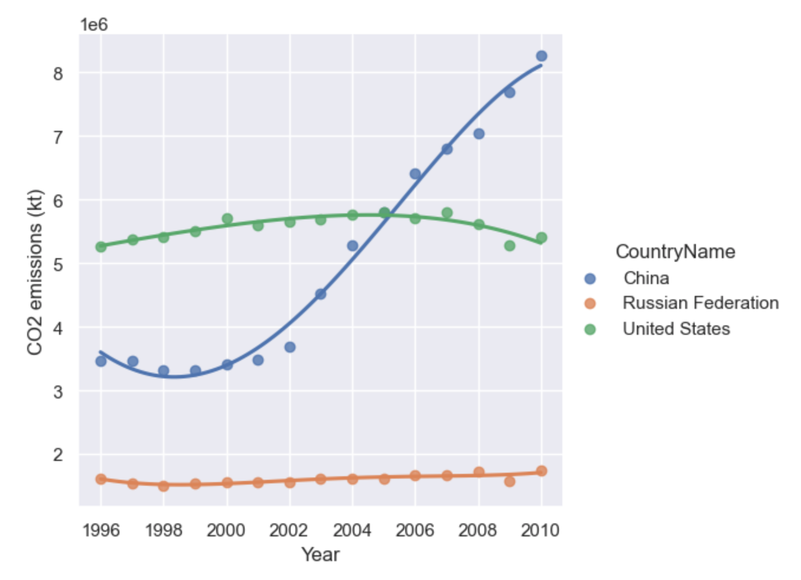
Statistics by country
Notes:
With the two line graphs we find that CO2 emissions and CO2 Damage for the United States and the Russian Federation are rising steadily or almost unchanged, but that China's CO2 emissions have increased dramatically since 2000.The main reason for a certain downward trend in 2009 is that the data for all three countries are lower than the fitted curves in that year. Therefore an overall downward trend is also observed in the quadrant plot. Since the inflection point of China's evolutionary trend is located between 2000 and 2004, we intercepted China's CO2-related data from 1995 to 2005 for further study.

Slide 5
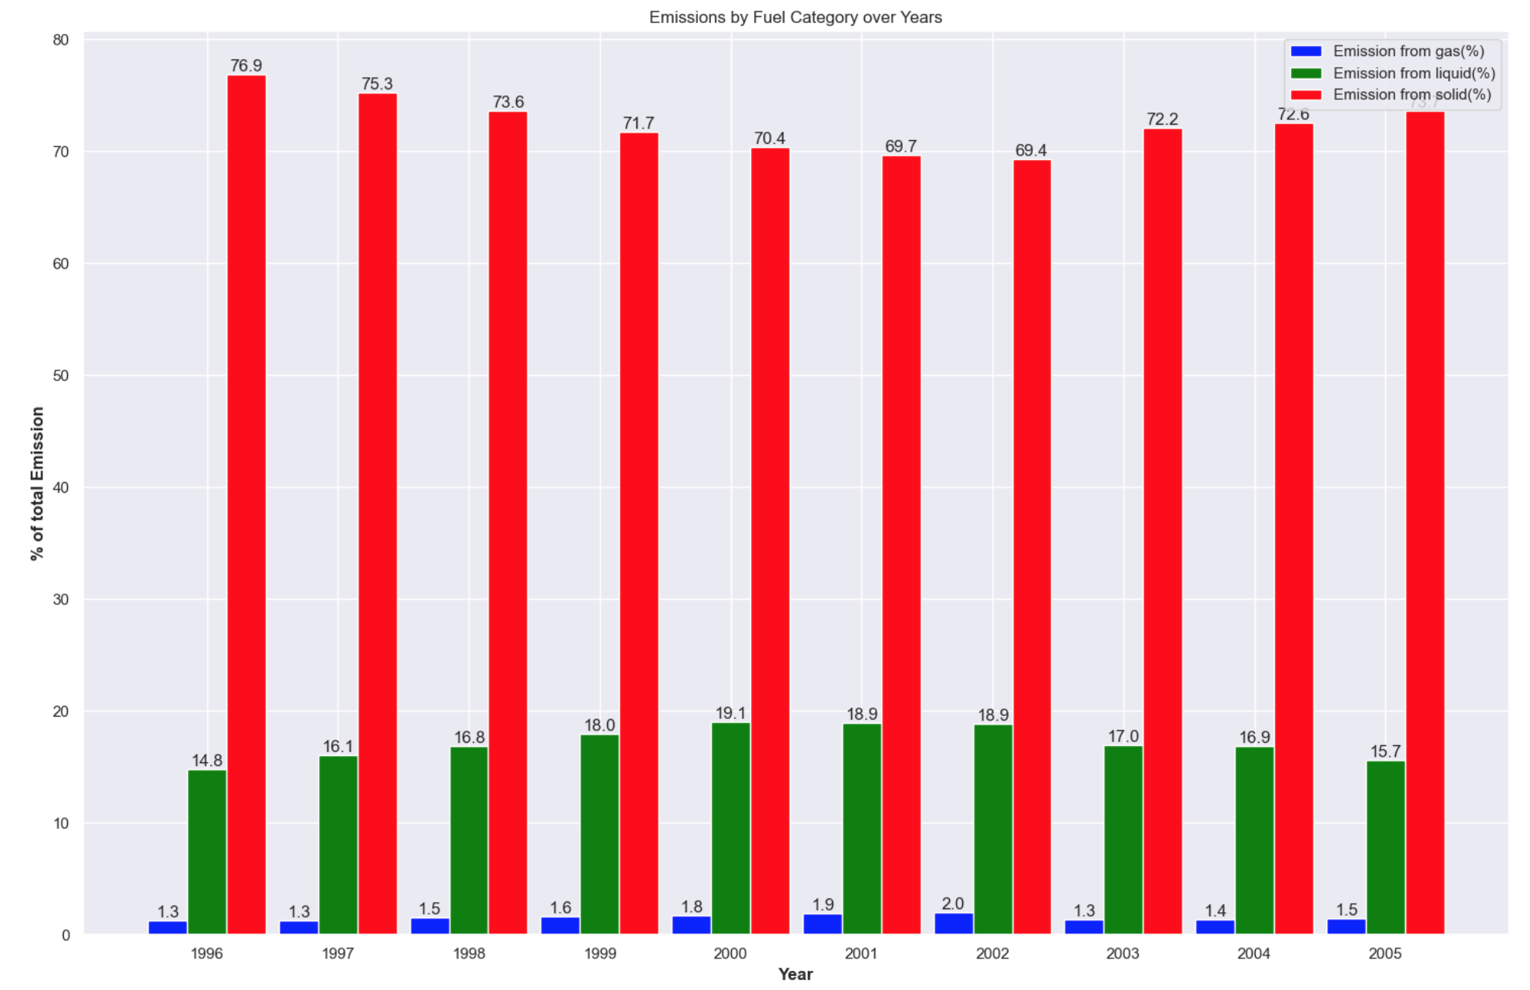
Emission by Fuel Category
The proportion of China's CO2 emissions originating from solid fuels is much higher than that from liquids and gases. The proportion of emissions from solid fuels tends to decrease and then increase. The proportion of emissions from liquid fuels increases and then decreases. The proportion of gaseous emissions remains almost constant.

Slide 6
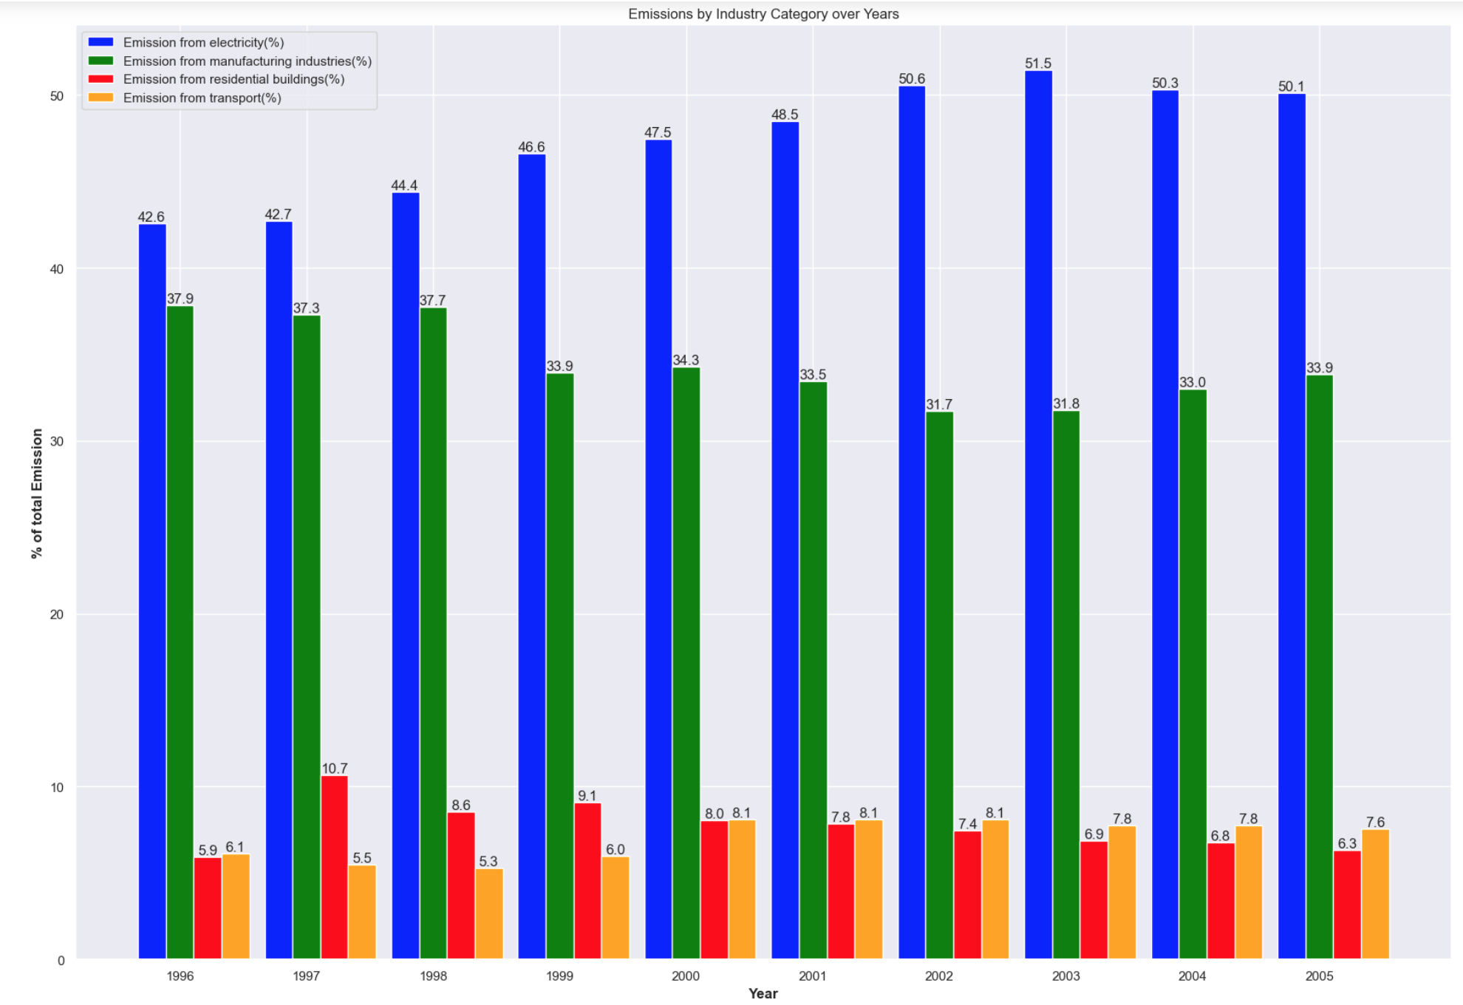
Emission by Industry Category
Notes:
According to the statistics of the proportion of emissions from different industries, it is found that the proportion of CO2 emissions from the electric power industry is the highest, and maintains a rising trend almost year by year. The second highest is from the manufacturing industry. The proportion of CO2 emissions from the construction and transportation industries is very low.

Slide 7
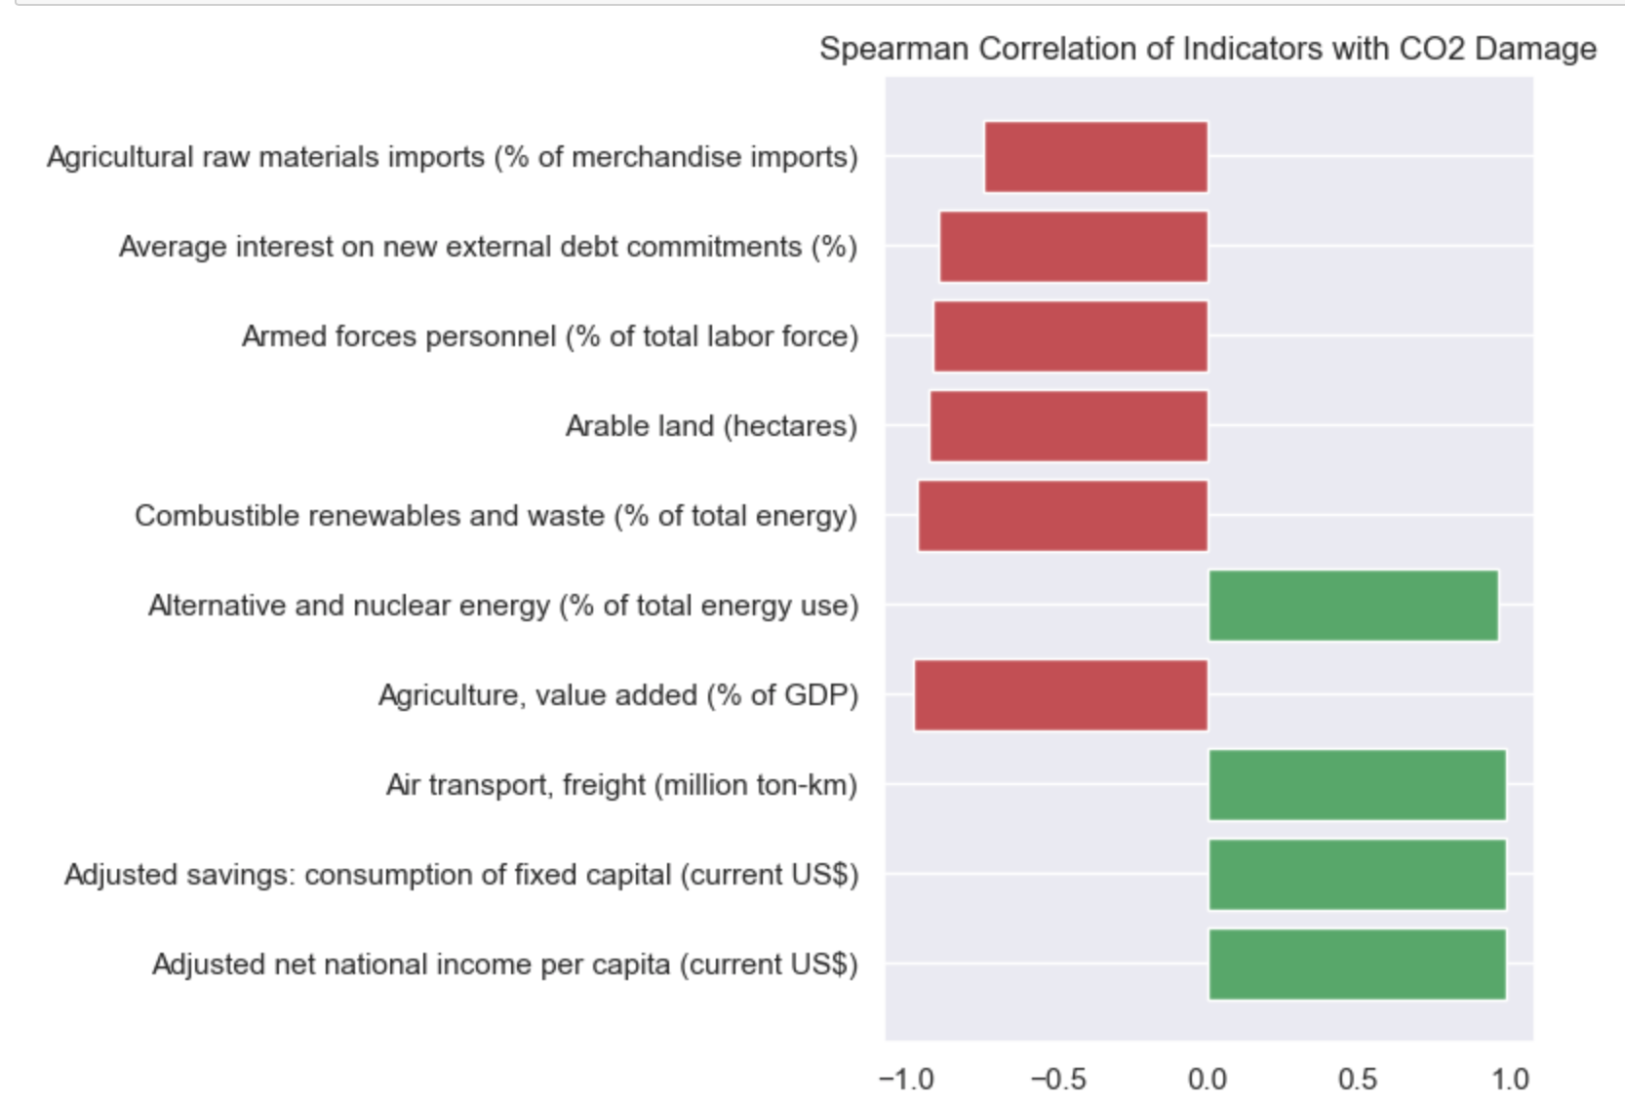
Variable correlation calculation
Notes:
After comparing the Spearman correlation coefficients for all Instruction, the 10 variables most correlated with CO2 Damage were identified and the correlation coefficients were plotted. The green color represents positive correlation and the red color represents negative correlation.

Slide 8
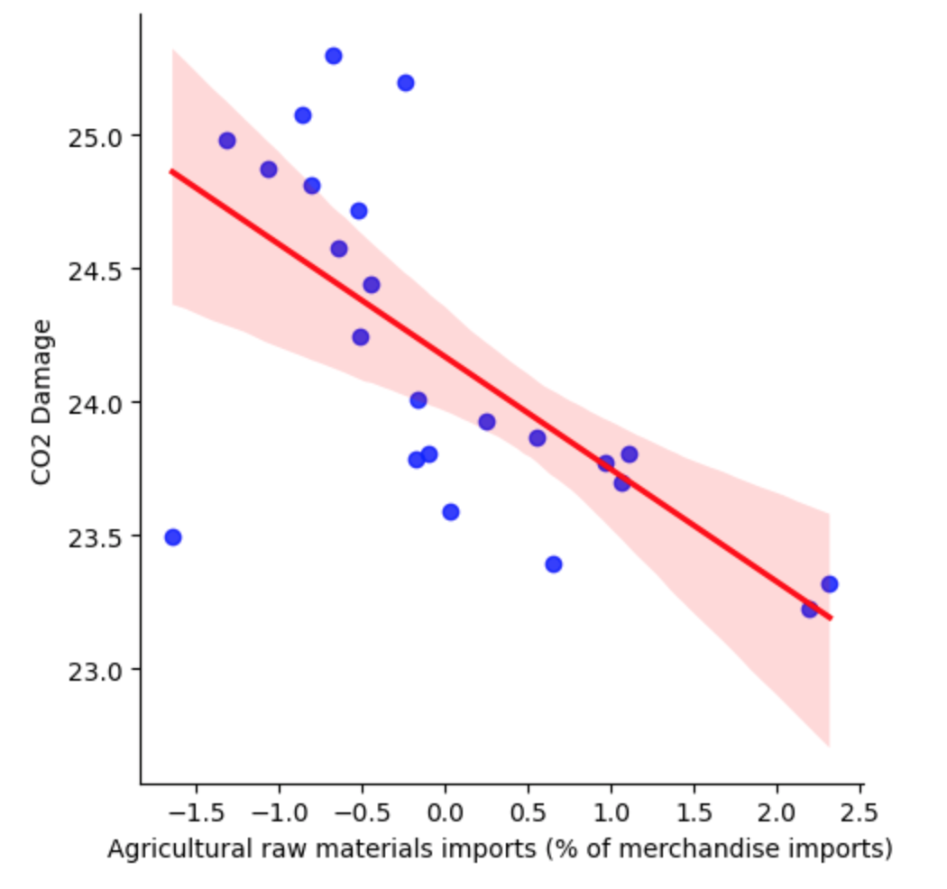
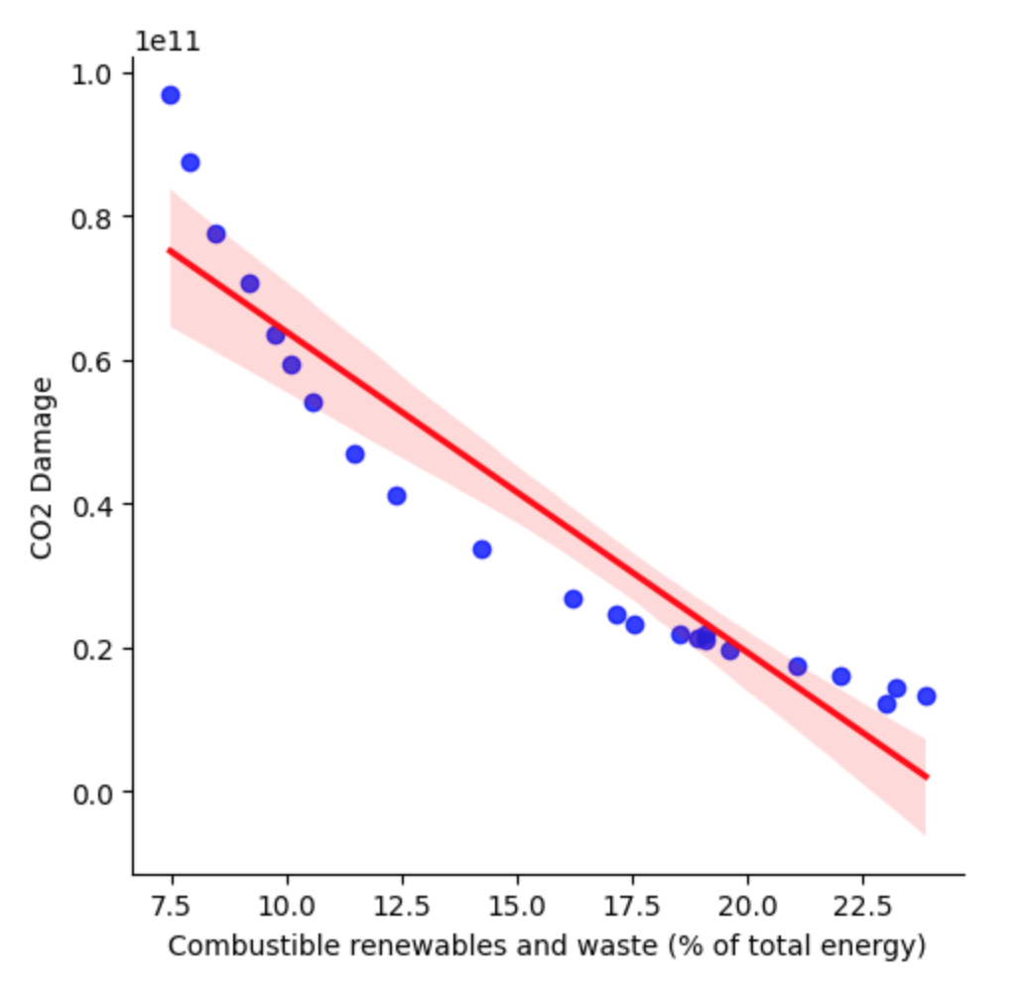
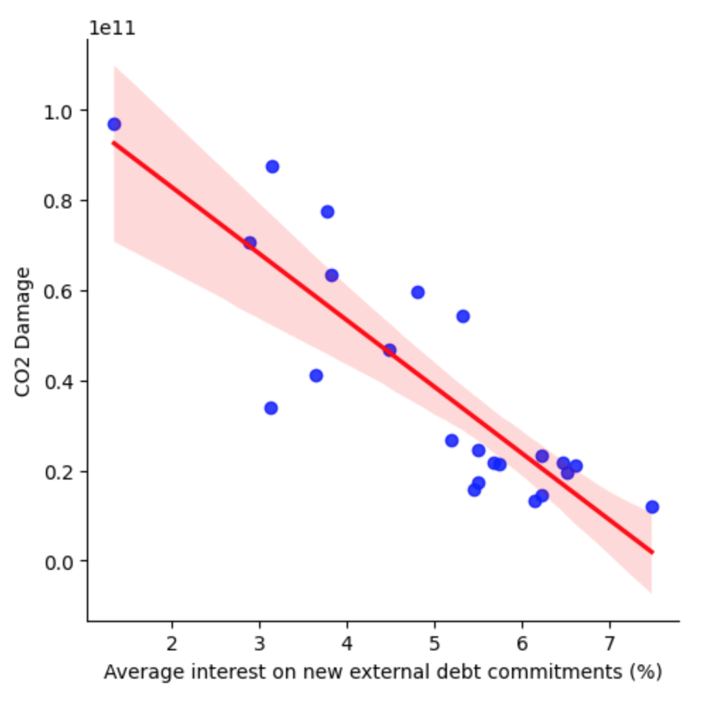
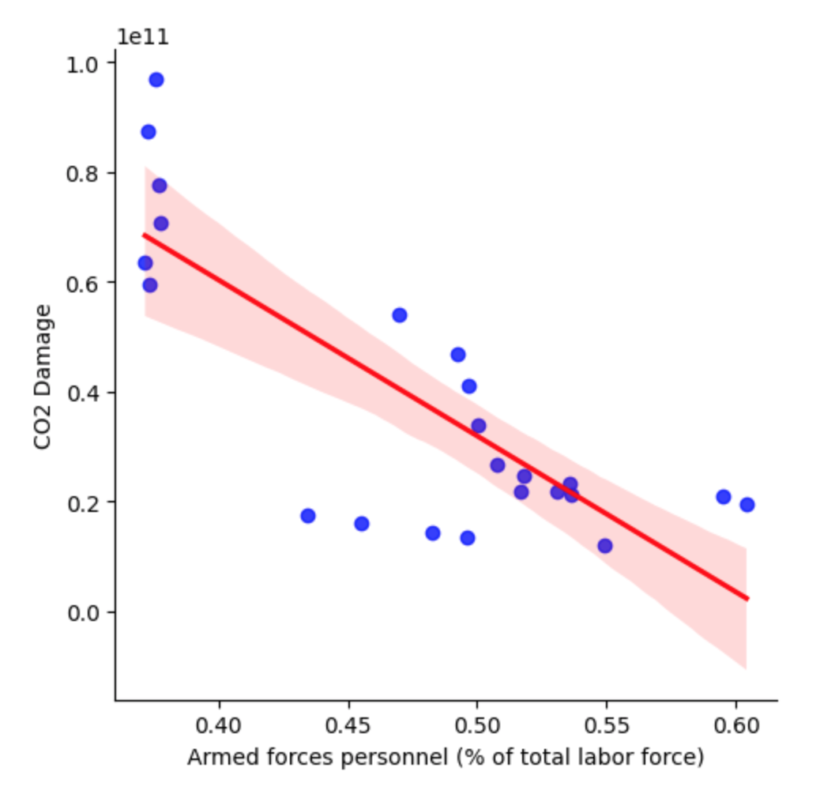
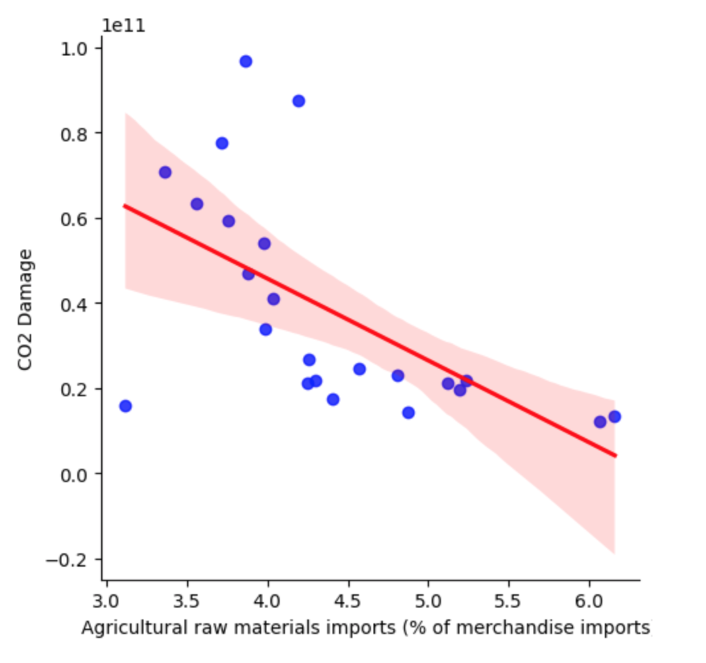
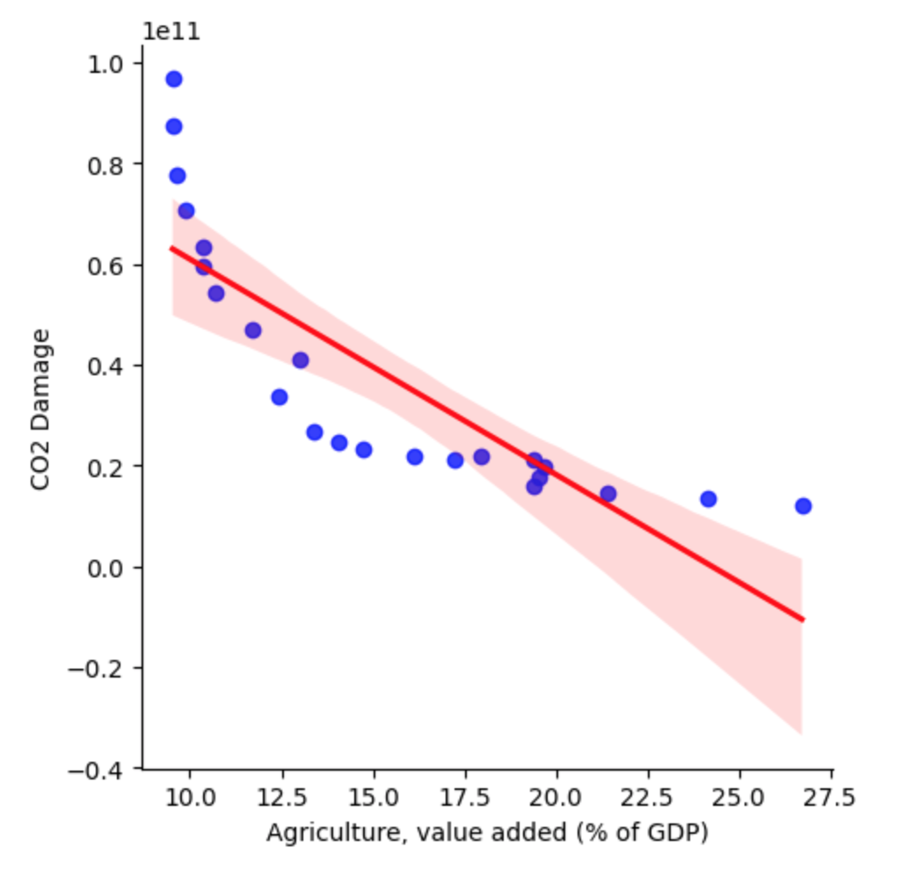
Exploratory data analysis
Notes:
First we normalize the data by z-score and construct the data into the same standard format. After that we analyze the data exploratively. These six variables are based on the relevant variables provided by me in the previous step, and then manually screened. We can see that all six variables have a clear negative trend with CO2 Damage. However, for Amed forces personal percentage and Agricultural materials imports percentage, they do not show a significant linear trend.

Slide 9
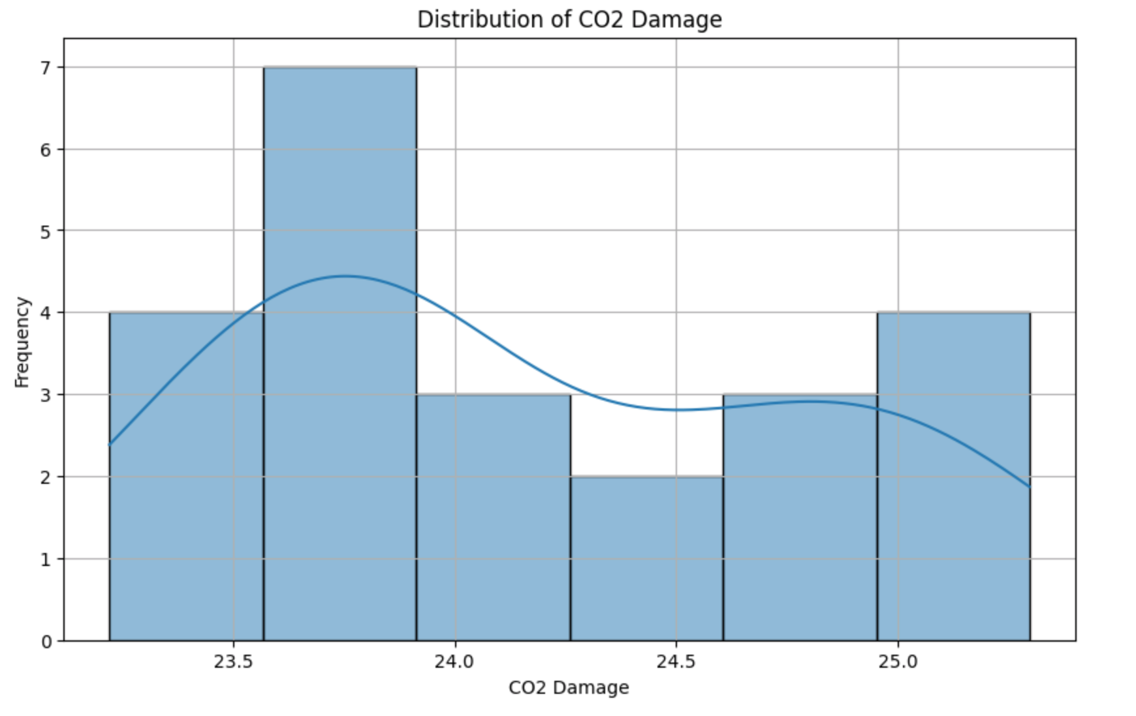
Exploratory data analysis
The "CO2 Damage" column has a mean of 24.17, a standard deviation of 0.65, a minimum value of 23.22 and a maximum value of 25.30.
The distribution of "CO2 Damage" is characterized by a certain degree of normal distribution.

Slide 10
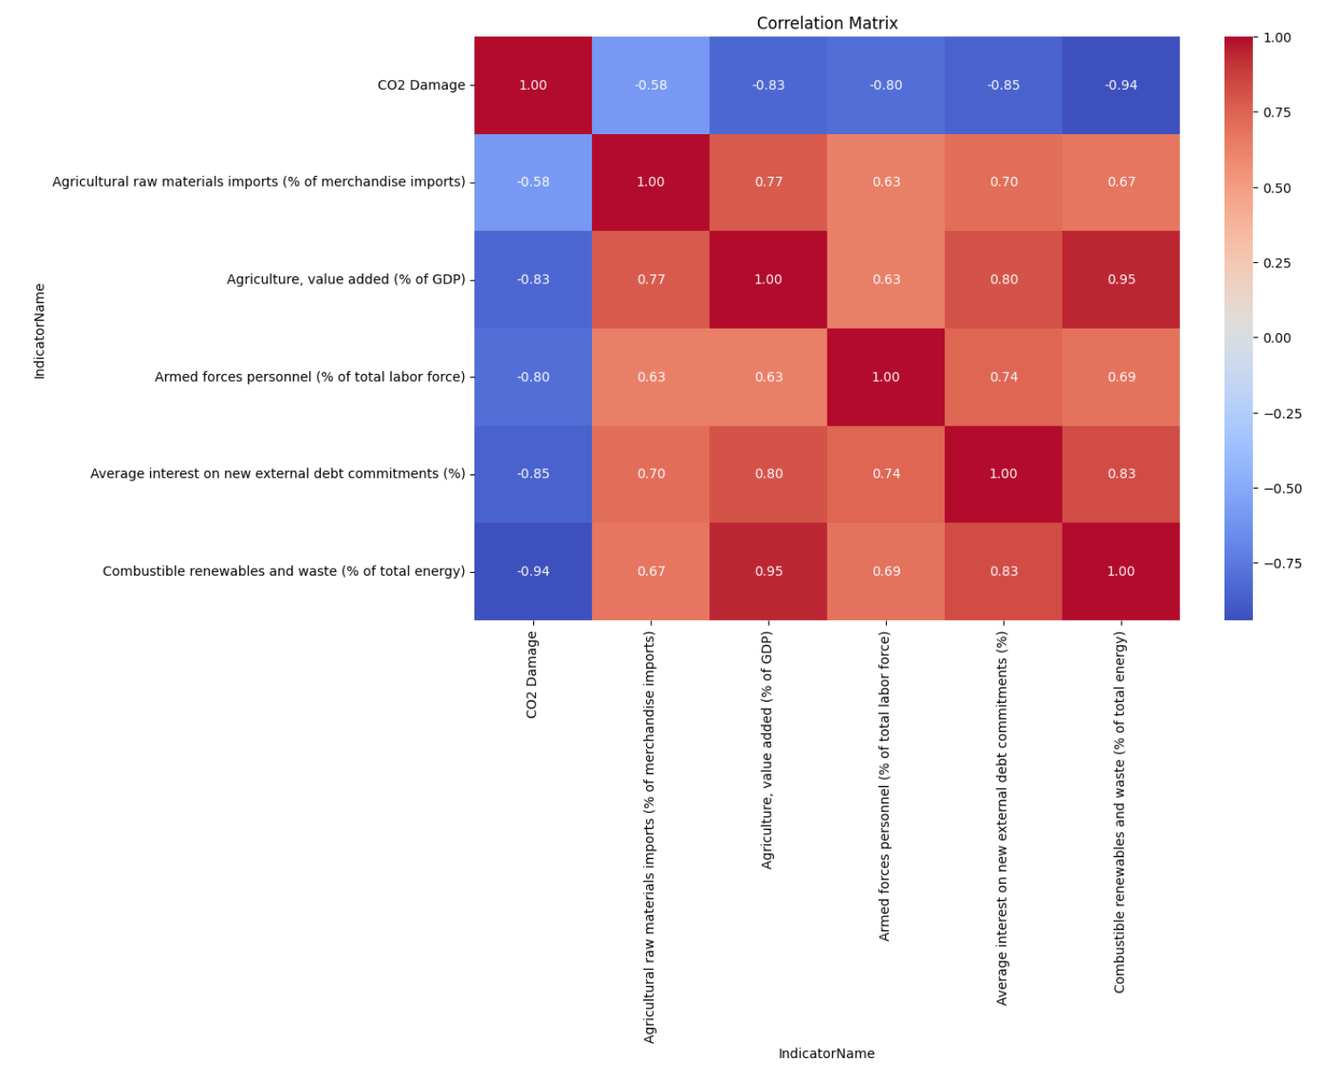
Exploratory data analysis
Based on the heat map of the correlation we can see that the negative correlation between Combustrible renewables and waste and CO2 Damage is the most obvious.

Slide 11
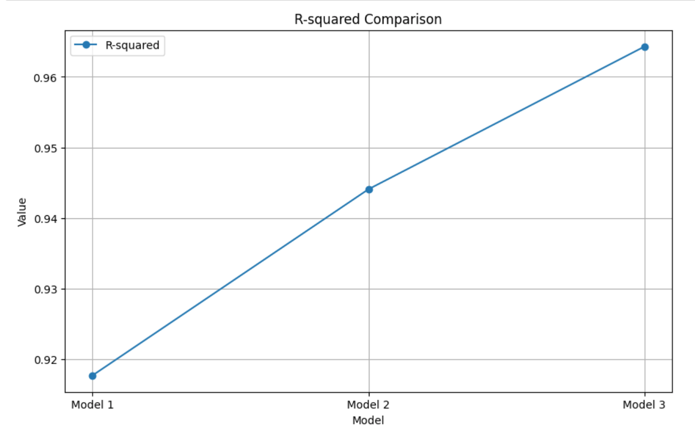
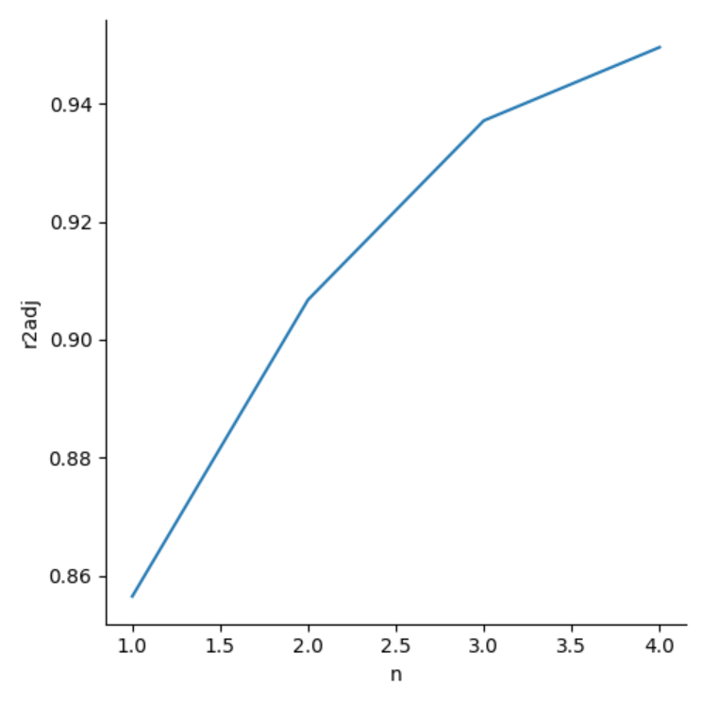
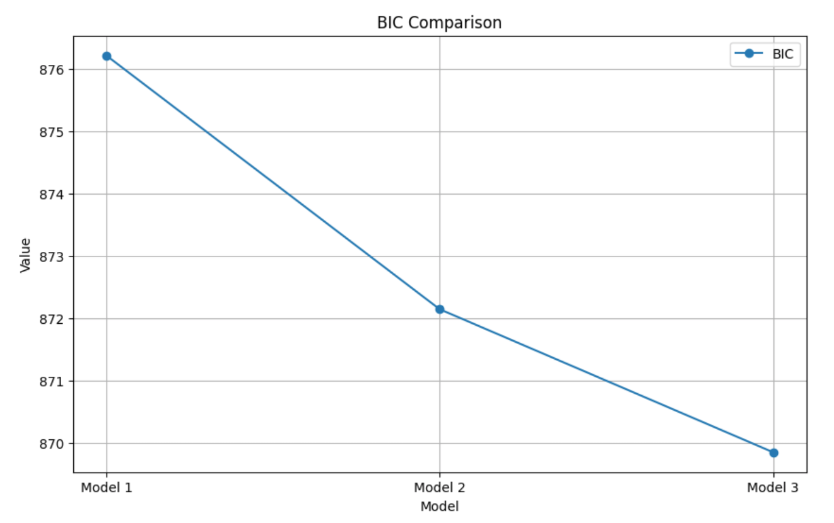
Linear model
Notes:
By plotting the line graphs corresponding to R2 for different numbers of variables, we found that a linear model constructed with three or four variables was better. We then tried to construct Model 1, Model 2, and Model 3 using 2, 3, and 4 variables respectively.By comparing their R-squared values AIC, and BIC we found that it is still best to use the model with all variables. Therefore, in the linear model, we kept Model3 for the subsequent cross-sectional comparison of the models.

Slide 12
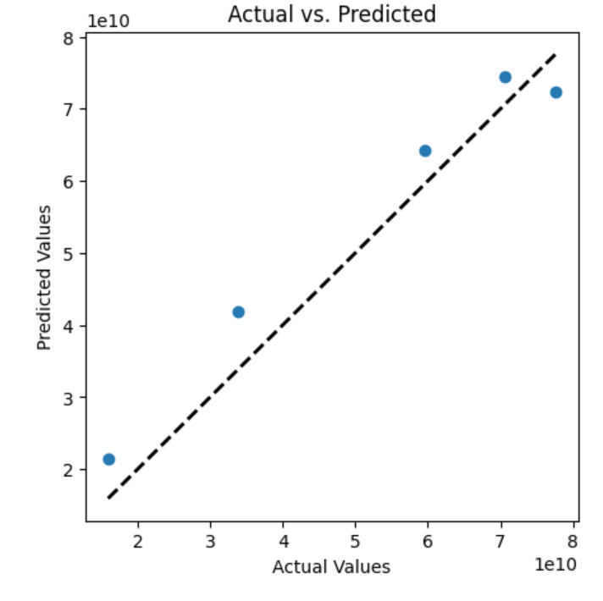
KNN Model
During my experiment, I got the optimal number of neighbors after the first training.
Then the model was re-tamed according to the optimal number of neighbors and the final prediction result was obtained.
We can find that the overall prediction results are more accurate.
Notes:
The working principle of KNN is based on finding out the nearest neighbors of a sample and predicting the class or value of that sample based on those neighbors. The distance metric we use here is Euclidean distance. In our regression task, the KNN model calculates the average or weighted average of the output values of the K neighbors as the predicted values.

Slide 13
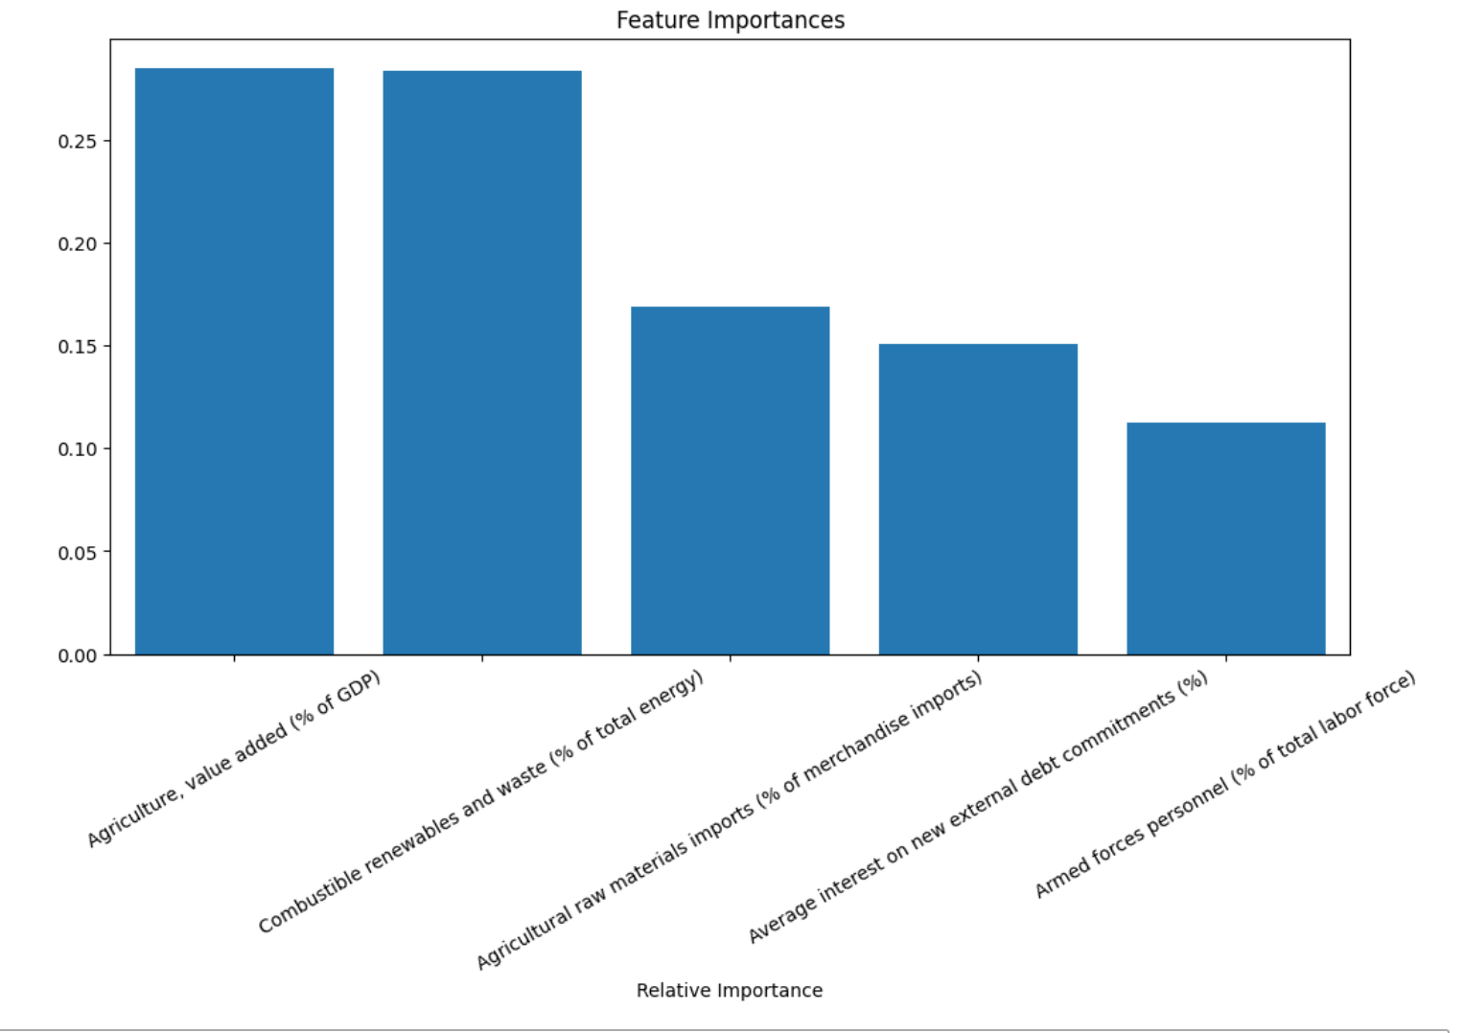
Random Forest Model
According to the predictions of Random Forest.
Agriculture,value added percentage, and Combustible renewables and waste have the greatest influence on the model's predictions. This is not entirely consistent with the results of the correlation heat map that we directly plotted at the beginning.
Notes:
A random forest consists of multiple decision trees. Each decision tree is a simple predictive model that makes decisions by dividing the data set into different branches. Each node of the decision tree is a test of an attribute, each branch represents a result of the test, and the leaf nodes of the tree represent the final decision or output values. In the course of the experiments, I used the k-fold method to avoid overfitting.

Slide 14
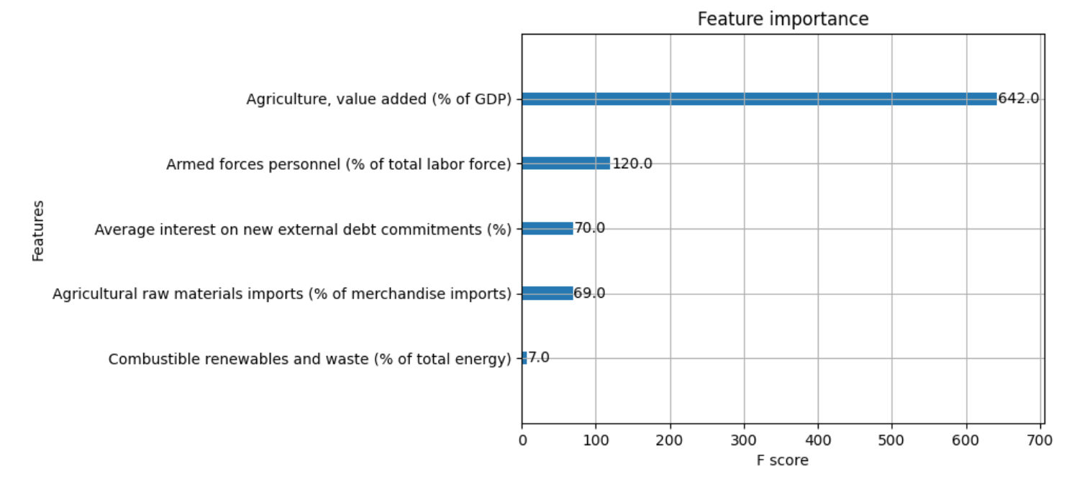
XGBOOST Model
In the experiments, I tested the effects of different n_estimators, learning_rate, and max_depth. The Best parameters were determined based on the test results.
In the optimized model, Agriculture, value added percetage variables is much more important than other variables for model prediction.
Notes:
XGBoost is based on the Gradient Boosting algorithm, which corrects the prediction error of the previous step by iteratively adding new decision trees. The tree added in each iteration is designed to reduce the residuals from the previous step

Slide 15
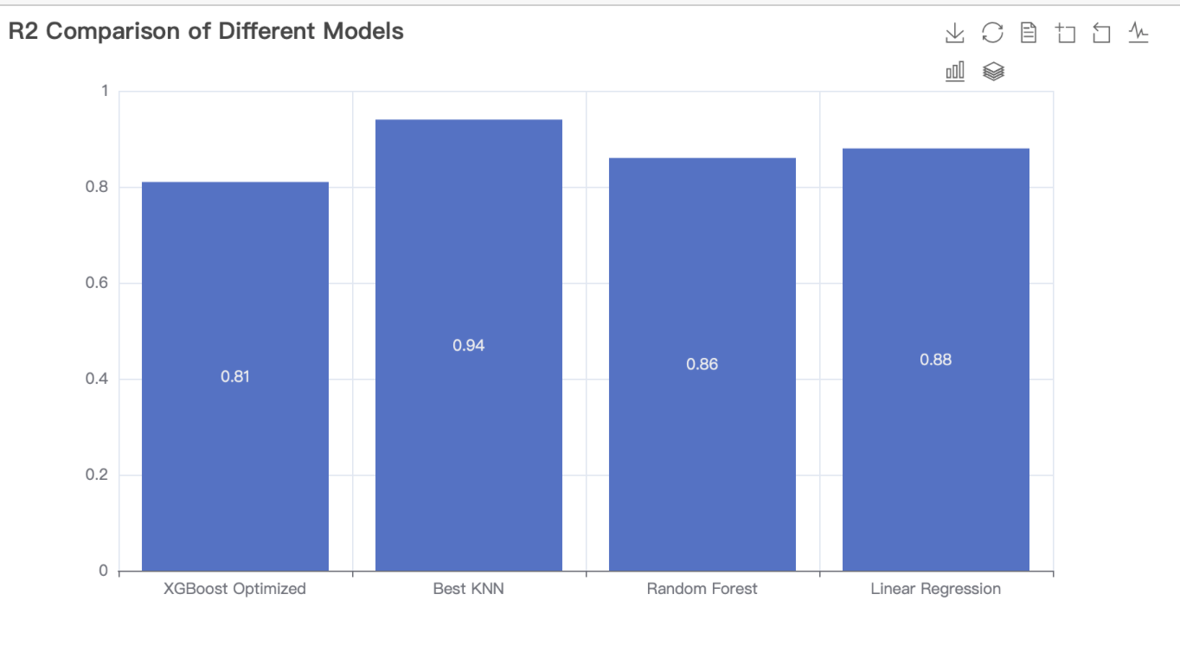
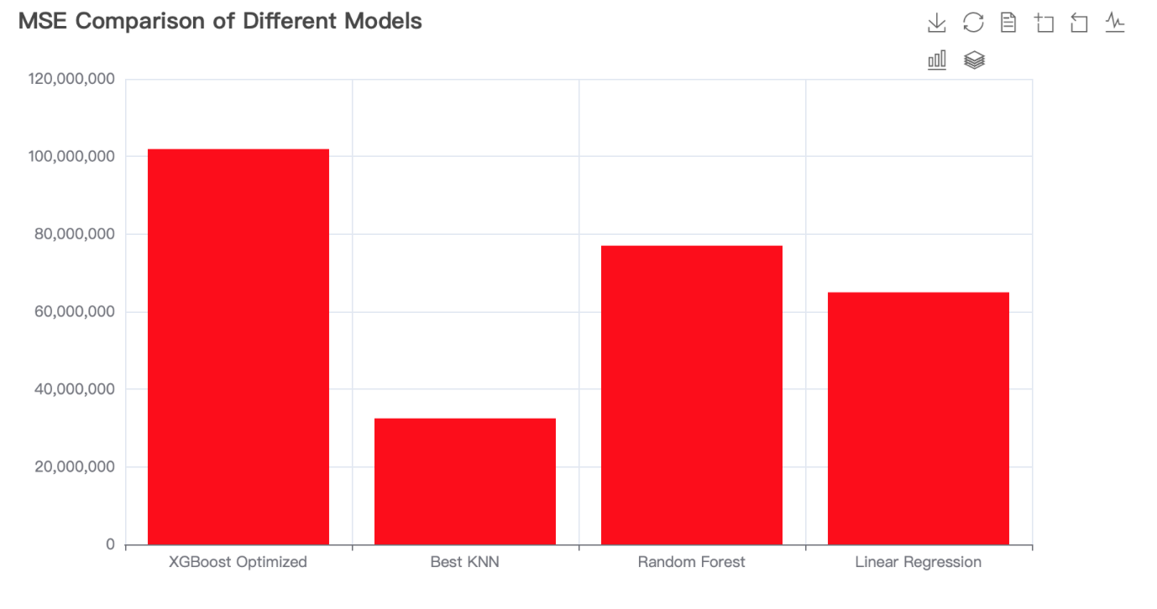
Model comparison
A side-by-side comparison of the R squared as well as MSE values of the four models reveals that the optimized KNN model has the best overall performance. It is followed by the linear regression model. Surprisingly, the XGBoost model performed the worst. This may be related to the parameter configuration of my model, and if the model needs to be further optimized, it needs to be re-test with different parameters for tuning.

Slide 16
Thanks

